Slide 1

Least Cost System Operation: Economic Dispatch 1
Smith College, EGR 325
March 3, 2006
some slides from T. Overbye, UIUC

Slide 2
Overview
Complex system time scale separation
Least cost system operation
  Economic dispatch first view
  Generator cost characteristics
    Four curves of generator performance
Constrained optimization
  Linear programming
  Economic dispatch completed

Slide 3
Long term system planning: Production cost
  Decide what to build
Hourly to monthly decisions: Unit commitment
  Decide which plants to have warmed up and ready to go
  Different technologies have different requirements
Minutes to Hour: Economic dispatch
  Decide which plants to use to meet the expected load now
  5 minutes to 1 hour
Cycles to Minutes: Short term system operations and Load Flow Model
  Maintain supply and demand balance moment to moment
  ~17msec per cycle up to 5 minute control functions

Slide 4
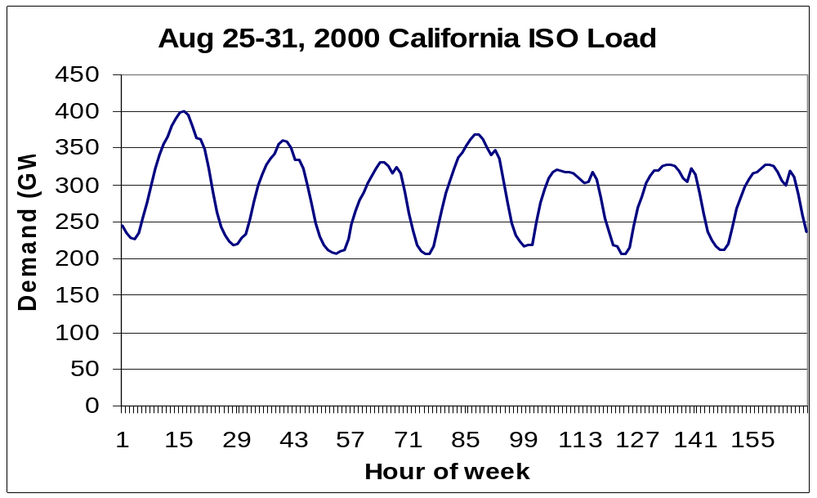
Power System Economic Operation
The installed generating capacity is greater than the load at any specific moment
This give us a lot of flexibility in deciding which generators to use to meet the load at any moment

Slide 5
What is “Economic Dispatch?”
Economic dispatch (ED) determines the least cost dispatch of generation for a system.
  To dispatch ≡ To order to generate (more) energy
Economic Dispatch (from EPACT 1992)
  The operation of generation facilities to produce energy at the lowest cost to reliably serve consumers, recognizing any operational limits of generation and transmission facilities.

Slide 6
Economic Dispatch Formulation
Focusing on our objective
  How do we represent our objective mathematically?
  What mathematical tool do we use to obtain this objective?
What does solving our (to be developed) set of equations help us to decide?

Slide 7
Economic Dispatch Formulation
Therefore we need to understand
  How to represent system generating costs mathematically
    Costs of operating (dispatching) generators
    Indirect costs associated with constraints on the system
  How to find the minimum system cost given
    Generator costs and
    System constraints
    ➔Constrained optimization via linear programming

Slide 8
Generator Cost Characteristics

Slide 9
Generator Costs
Many fixed and variable costs are associated with power system operation
  The major variable cost is associated with generation
The cost to generate a MWh can vary widely
  For thermal units we have well-defined equations to calculate generating costs
  For other generating units (e.g., hydro and nuclear) the cost is difficult to quantify

Slide 10
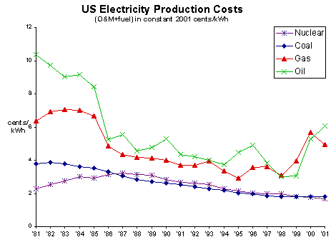
Time Variation in Costs

Slide 11
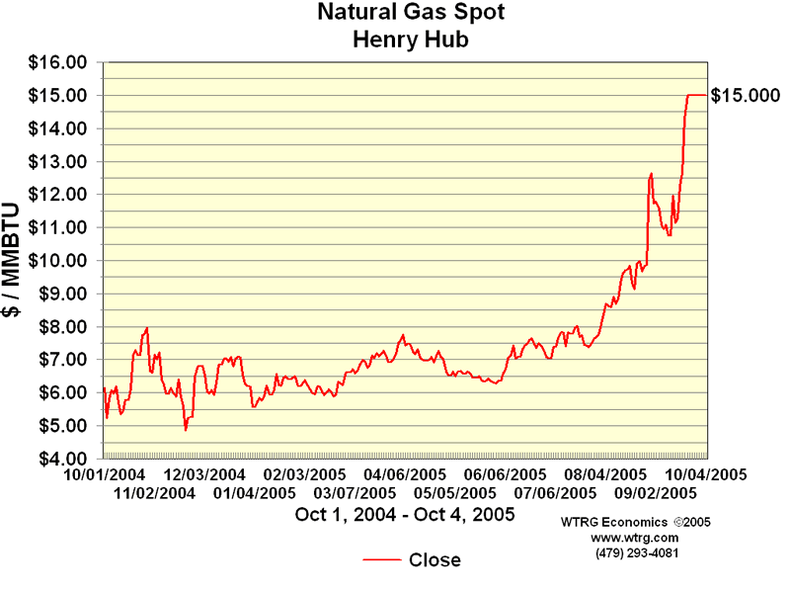
Natural Gas Prices Over the Years
(adjusted for inflation)
Peak was $15/Mbtu, current is $

Slide 12
As we have already seen, different generators are used in different ways, as determined by their different costs...

Slide 13
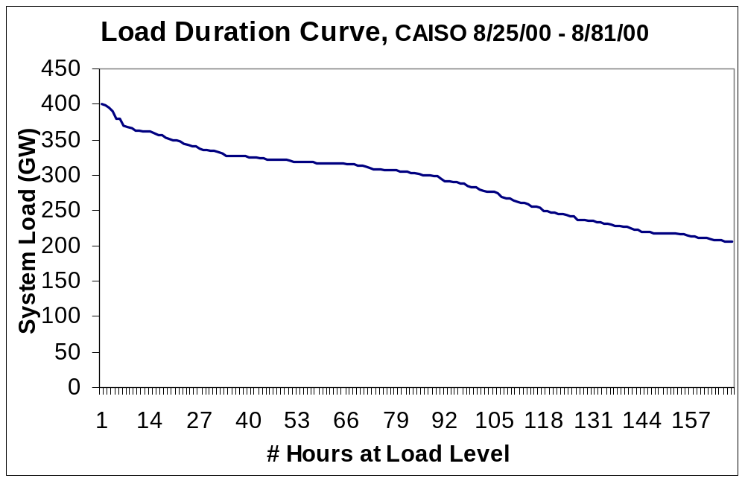
Generator Loading
Peak Load
Intermediate
Baseload

Slide 14
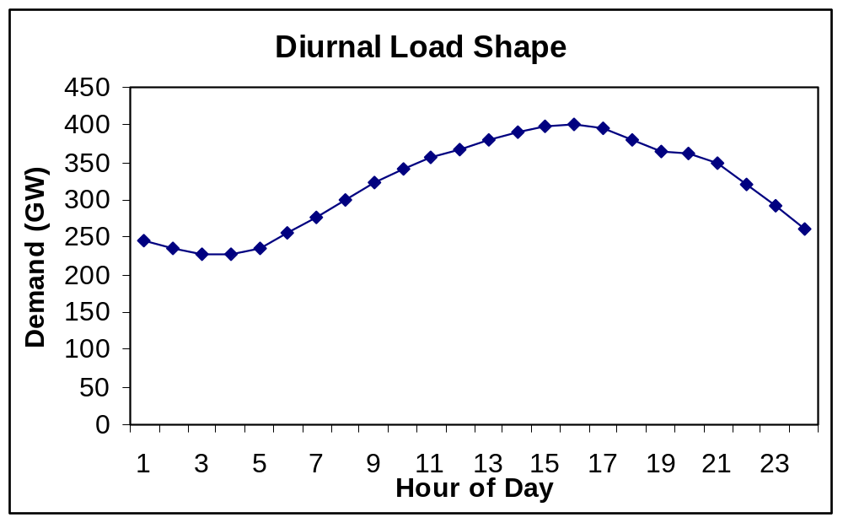
Generator Loading
Peak Load
Intermediate
Baseload

Slide 15
To minimize total system generating costs we develop cost relationships between cost of power output and operating costs, input
Gases
Steam
Stack
Boiler
Cooling
Tower
Thermal Turbine
Generator
G
Condenser
Pump
Coal feeder
Burner
Body of water

Slide 16
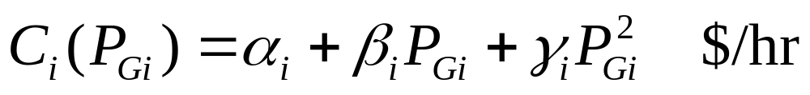
Mathematical Formulation of Costs
Typically curves can be approximated using
  quadratic or cubic functions
  piecewise linear functions
Relying on the quadratic nature of HR, we will use a quadratic cost equation
Standard quadratic representation is...?

Slide 17
Mathematical Formulation of Costs
From total cost to marginal cost...
The marginal cost is one of the most important quantities in operating a power system
  Marginal cost = incremental cost: the cost of producing the next increment of power (the next MWh)
How do we find the marginal cost?

Slide 18
Discussion Questions
If we have 3 generators, our first-pass system cost equation is...?
We find the minimum system cost by ...?
How do we then find values for P_{Gi} from each generator (our original goal)?
What is missing for the actual problem of finding the minimum system operating cost?

Slide 19
Summary
Formulated the economic dispatch problem conceptually
Examined the mathematical origin for generator costs
  Defined heat rate
Began mathematical formulation of the economic dispatch problem
To be completed next Wednesday

